Slide 1

SRI VENKATESWARA COLLEGE OF ENGINEERING & TECHNOLOGY(AUTONOMOUS)
DEPARTMENT OF COMPUTER SCIENCE & ENGINEERING
WELCOME TO Internship presentation
Heartly thankyou our respected principal Dr. M. Mohan babu and Head of Department Dr.P.Jyoteswari Madam
Special thanks to our class teacher Mr.Hare Ram Singh Sir.

Slide 2

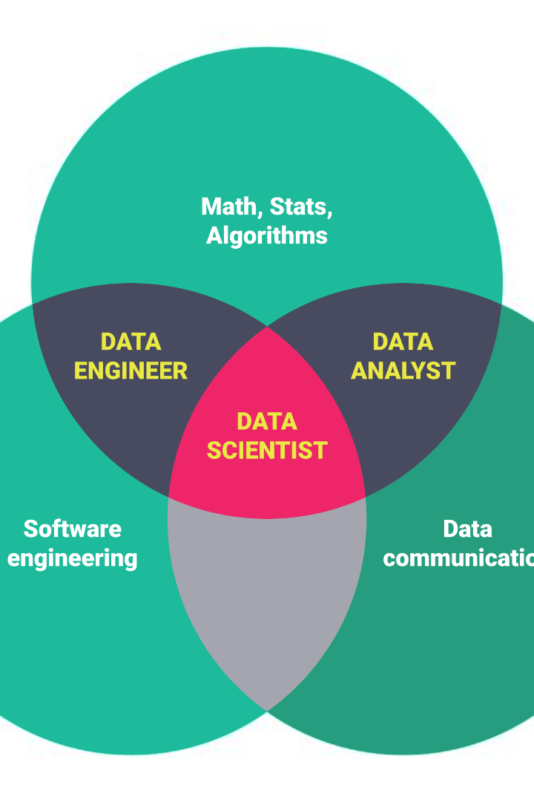
Data Science and Machine Learning
‘Online Insurance Analysis’ & ‘SMS Spam Classifier’
Unlock the power of data with the fusion of data science and machine learning. Explore the fascinating world of intelligent algorithms and predictive modeling to gain valuable insights.
BY Samir Tamang
IV year CSE- ’B’
20781A05H5

Slide 3

YBI Foundation
The YBI Foundation is a non-profit organization dedicated to empowering young entrepreneurs around the world. Through various programs and initiatives, the foundation provides training, mentorship, and financial support to help young entrepreneurs start and grow their businesses. With a focus on innovation and sustainability, the YBI Foundation aims to create a global network of young entrepreneurs who can make a positive impact in their communities and contribute to economic growth.

Slide 4
Topics in Data Science and Machine Learning
Introduction to Data Science
Machine Learning Algorithms
Data Visualization
Python language
Natural Language Processing
Big Data Analytics
Feature Engineering
Model Evaluation and Selection
Time Series Analysis
Recommendation Systems

Slide 5

Data Science Overview
Big Data Revolution
Problem Solving
Discover how data science is revolutionizing industries by leveraging massive amounts of structured and unstructured data.
Learn how data science solves complex problems by extracting valuable knowledge and making data-driven decisions.
Ethics & Privacy
Explore the ethical considerations and privacy concerns associated with handling and analyzing vast amounts of sensitive data.
Key Components
Understand the essential components of data science, including data collection, data cleaning, data analysis, and data visualization.

Slide 6
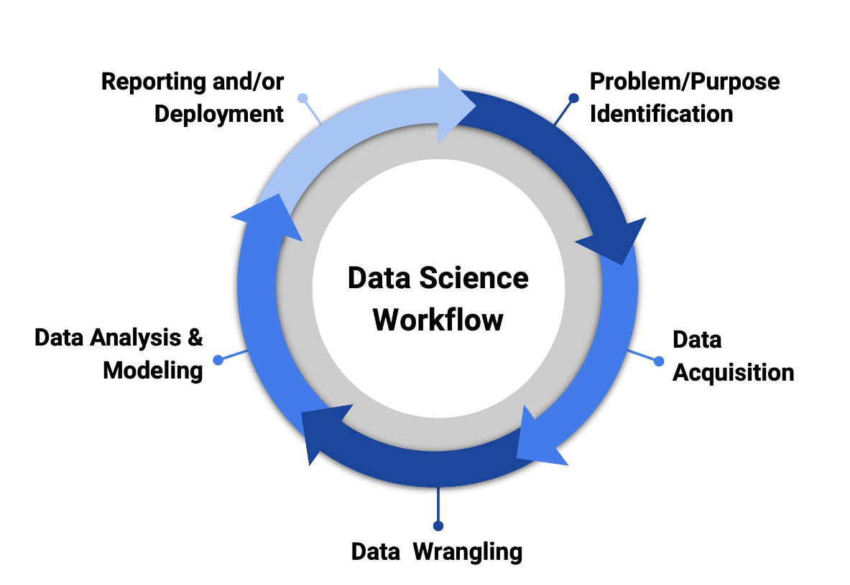
Flowchart of Data Science:

Slide 7
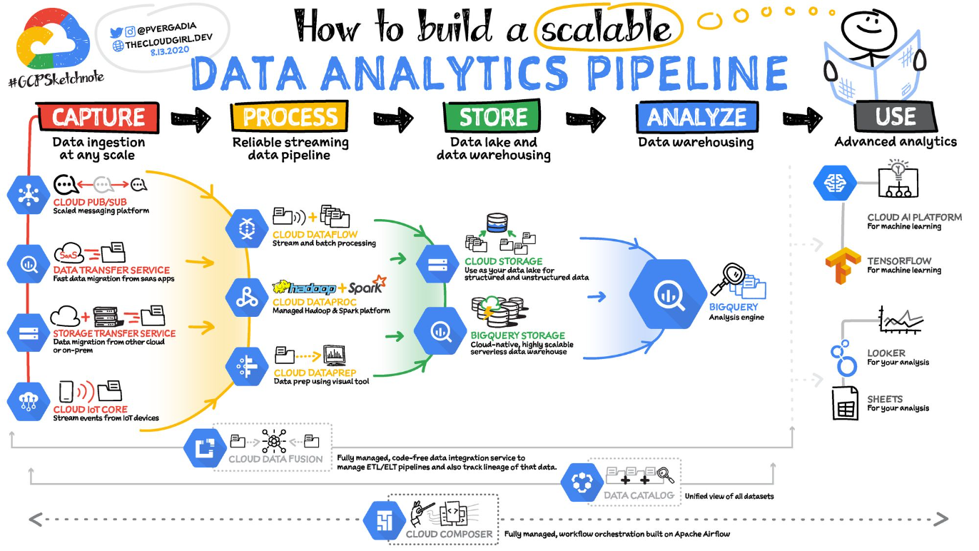
Architecture of Data Science:

Slide 8

Types of Data
1
Structured Data
2
Unstructured Data
Delve into organized and well-defined data that fits neatly into traditional databases and spreadsheets.
Explore the challenges and possibilities of analyzing unstructured data, such as text, images, audio, and video.

Slide 9
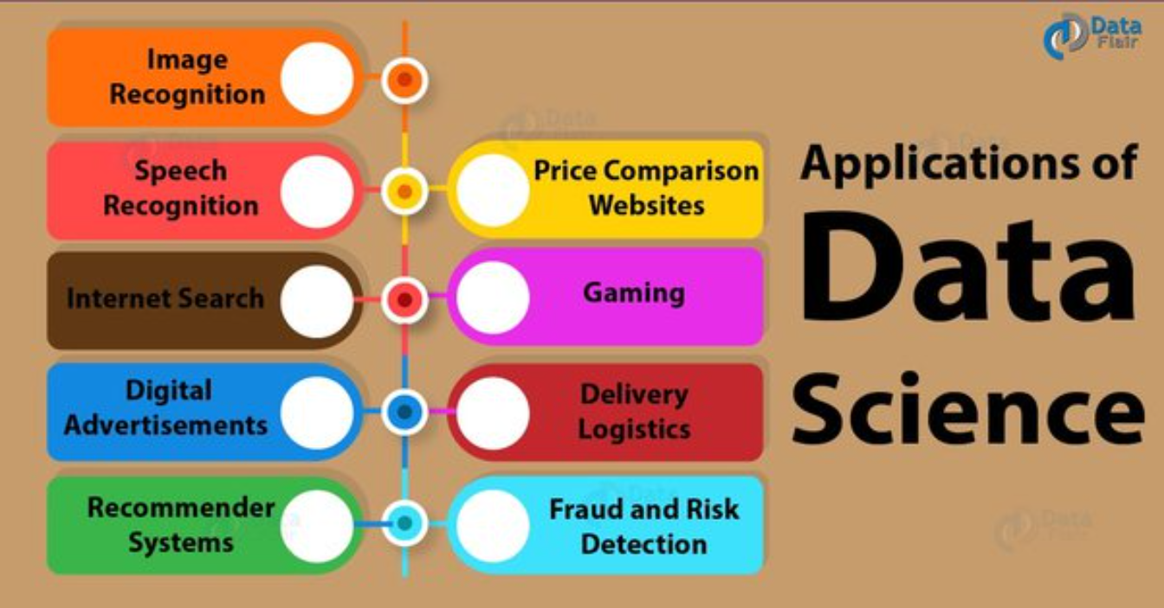

Slide 10
Introduction to Machine Learning
Supervised Learning
Unsupervised Learning
Reinforcement Learning
Uncover the fundamentals of supervised learning where models are trained on labeled data to make accurate predictions.
Dive into the world of unsupervised learning, where algorithms uncover patterns and relationships in unlabeled data.
Discover how reinforcement learning enables machines to learn through trial and error, guided by feedback from their environment.

Slide 11
1
Classification
Classification is a machine learning technique used to predict the category or class of a given input based on its features. It assigns a label or category to new, unseen data based on patterns learned from labeled training data. Classification algorithms include decision trees, logistic regression, and support vector machines.
Regression
2
Regression is a machine learning technique used to predict a continuous numerical value based on input variables. It models the relationship between the input variables and the target variable to make predictions. Regression algorithms include linear regression, polynomial regression, and random forest regression.
3
Association
Association is a machine learning technique used to discover interesting relationships or patterns in large datasets. It identifies frequent itemsets or co-occurrences among items and generates association rules. Association algorithms include Apriori and FP-Growth.
Clustering
4
Clustering is a machine learning technique used to group similar data points together based on their characteristics or features. It aims to find natural groupings or clusters in the data. Clustering algorithms include k-means, hierarchical clustering, and DBSCAN.

Slide 12
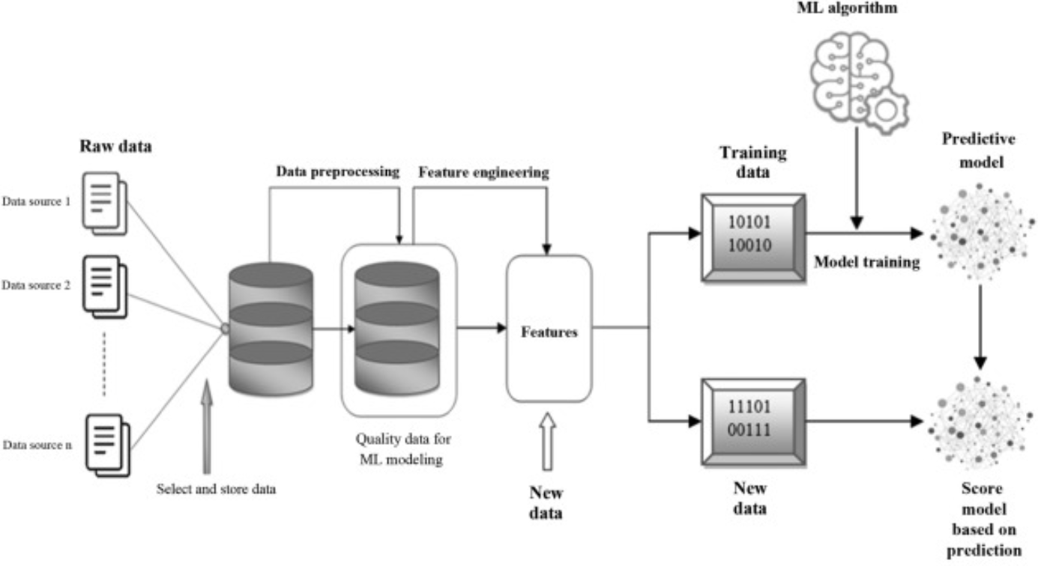
Architecture of Machine Learning:

Slide 13
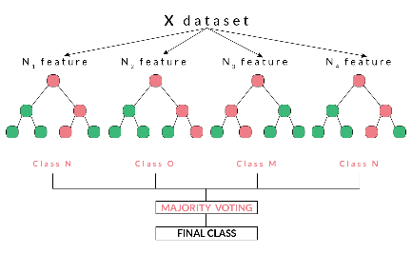
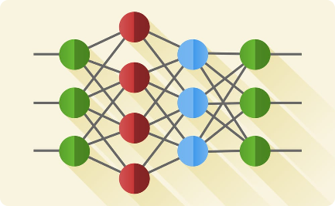
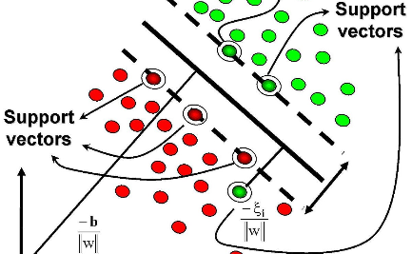
Machine Learning Algorithms
Random Forest
Neural Network
Support Vector Machine
Learn how this versatile ensemble algorithm combines the predictions of multiple decision trees to improve accuracy.
Unveil the power of artificial neural networks in simulating the human brain and solving complex problems.
Discover how SVMs classify data by constructing hyperplanes in multidimensional space.

Slide 14
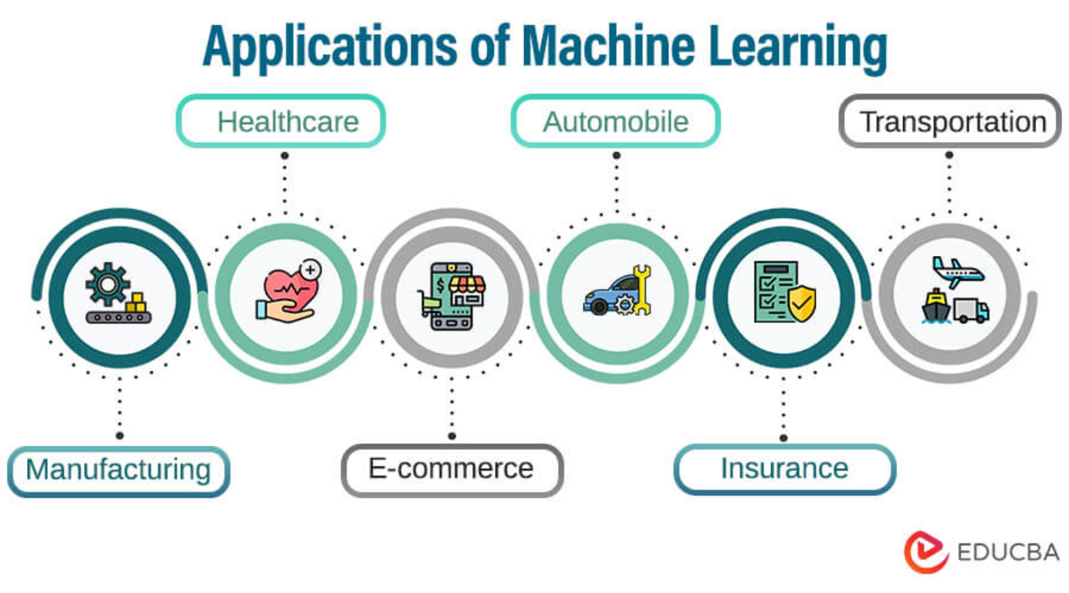

Slide 15
About Python
Python is a high-level programming language that is known for its simplicity and readability. It was created by Guido van Rossum and first released in 1991. Python has gained popularity in various domains, including web development, data analysis, artificial intelligence, and more.
Some key features of Python include:
Easy-to-understand syntax
Extensive standard library
Support for multiple programming paradigms
Large community and ecosystem

Slide 16
Python Libraries Used in Data Science
NumPy
Pandas
Scikit-learn
TensorFlow
A powerful library for numerical computing in Python, providing support for large, multi-dimensional arrays and mathematical functions.
A data manipulation and analysis library that provides data structures like DataFrames and tools for reading, writing, and analyzing data.
A machine learning library that provides a wide range of algorithms and tools for tasks such as classification, regression, clustering, and dimensionality reduction.
An open-source library for machine learning and deep learning developed by Google, widely used for tasks like neural networks, natural language processing, and computer vision.

Slide 17
Demo Of Code
import streamlit as st
import pandas as pd
import plotly.express as px
from streamlit_option_menu import option_menu
from numerize.numerize import numerize
from query import *
import time
st.set_page_config(page_title="Dashboard", page_icon="🌍",layout="wide")
st.subheader("🚮Insurance Details Analysis")
st.markdown("##")
result=view_all_data()
df=pd.DataFrame(result,columns=["Policy","Expiry","Location","State","Region","Investment","Construction","BusinessType","Earthquake","Flood","Rating","id"])
#side bar images
st.sidebar.image("logo1.png",caption="Online Analysis")

Slide 18
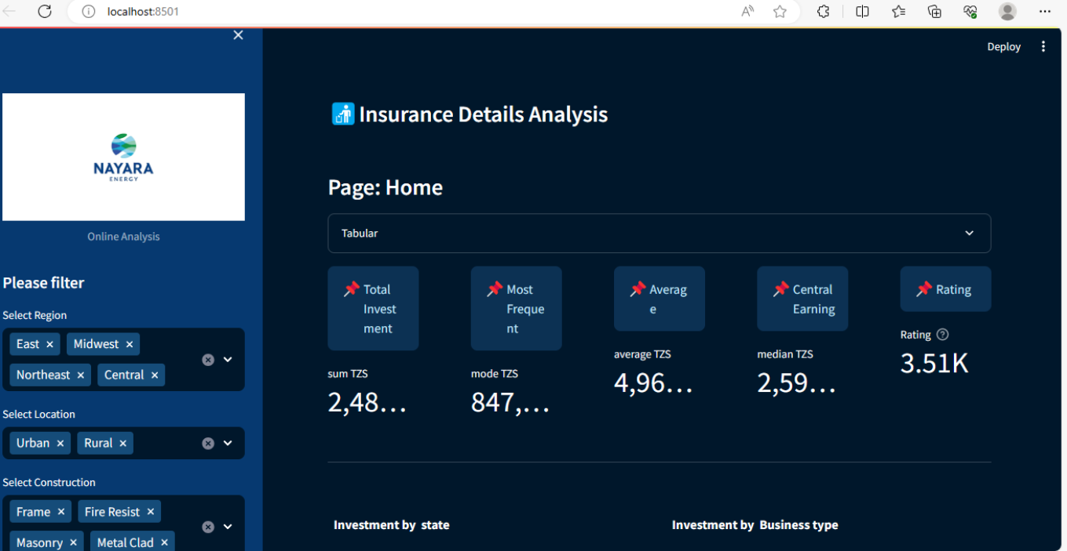
Output of Project:

Slide 19


Slide 20
Challenges and Limitations
1
Data Quality
Address the challenges posed by incomplete, inaccurate, or biased datasets that can affect the performance and fairness of machine learning models.
Interpretability
2
Explore the black box problem and the need for transparent and interpretable machine learning models.
3
Ethical Considerations
Discuss the ethical challenges surrounding responsible data usage and the potential for reinforcing biases or invading privacy.

Slide 21

Why Data science and machine learning are essential for future?
It is essential for solving complex problems and extracting valuable insights from vast amounts of data. Here are some key reasons why they are needed:
Data-driven Decision Making: Data science and machine learning enable organizations to make informed decisions based on data analysis and predictive modeling, leading to improved efficiency, accuracy, and profitability.
Predictive Analytics: By leveraging historical data and machine learning algorithms, businesses can predict future trends, customer behavior, and market dynamics, allowing them to proactively adapt and stay ahead of the competition.
Personalization: Data science and machine learning empower businesses to deliver personalized experiences to customers, tailoring products, recommendations, and marketing campaigns based on individual preferences and behaviors.
Automation and Efficiency: Data science and machine learning algorithms automate repetitive tasks, optimize processes, and streamline operations, saving time and resources while improving productivity.
Fraud Detection and Security: With the increasing threat of cybercrime, data science and machine learning play a crucial role in detecting fraudulent activities, identifying patterns, and strengthening security measures.
Healthcare and Medicine: Data science and machine learning have the potential to revolutionize healthcare by enabling accurate diagnosis, personalized treatment plans, drug.
These are just a few examples of why data science and machine learning are needed. Their applications span across various industries and domains, driving innovation, efficiency, and better decision-making.

Slide 22
Conclusion
Data science and machine learning are rapidly growing fields that have revolutionized the way we analyze and interpret data. With the help of powerful tools and algorithms, we can uncover valuable insights, make informed decisions, and build predictive models.
By leveraging Python libraries like NumPy, Pandas, Scikit-learn, and TensorFlow, data scientists and machine learning practitioners can effectively manipulate, analyze, and model complex datasets. These libraries provide a wide range of functions and algorithms that enable us to tackle a variety of tasks.
As the field continues to evolve, it's crucial to stay updated with the latest advancements and techniques. Continuous learning and experimentation are key to unlocking the full potential of data science and machine learning.

Slide 23
Thank you Have a Good day

